Slide 1
Nlets Overview

Slide 2
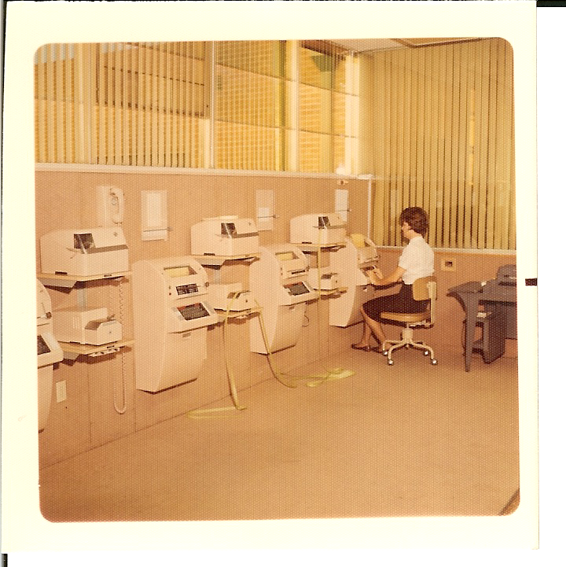
In the mid 60s representatives from the states agreed on the development of a nationwide interstate communications system.
In May of 1967 the LETS
(Law Enforcement Telecommunication System) was installed in Phoenix, AZ.

Slide 3
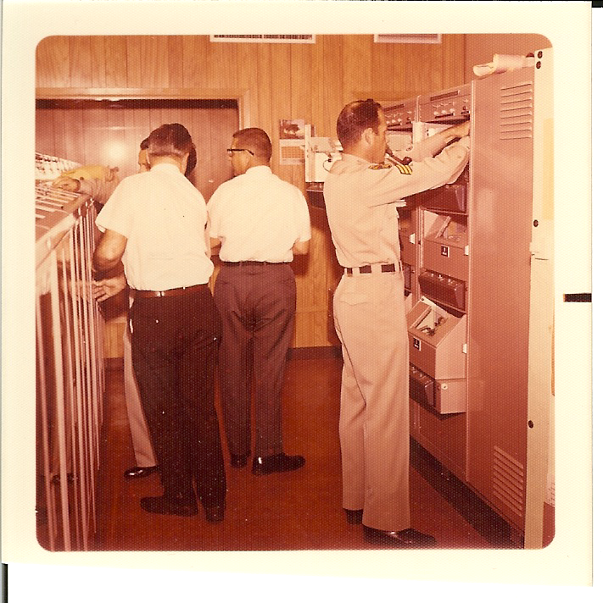
We have existed for 50 years to connect all 50 states, the District of Columbia, Puerto Rico, Virgin Island, Guam, and Canada along with 28 federal agencies and various associate members for the secure exchange of criminal justice data necessary to complete our law enforcement, justice, and public safety mission.

Slide 4
Nlets is NOT the same as NCIC!

Slide 5
The FBIs NCIC is a computerized index of criminal justice information. It is available to federal, state, and local law enforcement and other criminal justice agencies.

Slide 6
Nlets is a self funded, private, not for profit corporation that has created dozens of secure partnerships for data exchange.
We are owned and governed solely by the 54 lead law enforcement agencies that make up the principal customers of Nlets.

Slide 7
Core Members
Principal
Associate
Federal
Int’l
Strategic partners must serve the same mission that Nlets pursues.

Slide 8
Principal, (States, Commonwealths, Territories)*
Alabama Criminal Justice Information Center
Alaska Department of Public Safety
Arizona Department of Public Safety
Arkansas Crime Information Center
California Department of Justice
Colorado Bureau of Investigation
Connecticut Dept of Emergency Svcs & Public Protection
DC Metropolitan Police Department
Delaware State Police
Florida Department of Law Enforcement
Georgia Bureau of Investigation
Hawaii Criminal Justice Data Center
Idaho State Police
Illinois State Police
Indiana State Police
Iowa Department of Public Safety
Judiciary of Guam
Kansas Bureau of Investigation
Kentucky State Police
Louisiana State Police
Maine State Police
Maryland State Police Headquarters
Massachusetts Executive Office of Public Safety & Security
Michigan State Police
Minnesota Department of Public Safety
Mississippi Department of Public Safety
Missouri State Highway Patrol
Montana Department of Justice
Nebraska State Police
Nevada Department of Public Safety
New Hampshire State Police
New Jersey State Police
New Mexico Department of Public Safety
New York State Police
North Carolina State Bureau of Investigation
North Dakota Dept. of Emergency Services
Ohio State Highway Patrol
Oklahoma Department of Public Safety
Oregon State Police
Pennsylvania State Police
Puerto Rico Department of Justice
Rhode Island State Police
South Carolina Law Enforcement Division
South Dakota Department of Public Safety
Tennessee Bureau of Investigation
Texas Department of Public Safety
United States Virgin Islands Police Department
Utah Bureau of Criminal Identification
Vermont Department of Public Safety
Virginia State Police
Washington State Patrol
West Virginia State Police
Wisconsin Department of Justice
Wyoming Division of Criminal Investigation
*Non-federal criminal justice agencies assigned Nlets control terminal responsibilities

Slide 9
Federal*
Administrative Office of U.S. Courts
Bureau of Consular Affairs/ DOS Passport Services
El Paso Intelligence Center (EPIC)
Federal Bureau of Investigation / NCIC
Federal Bureau of Prisons
Federal Motor Carrier Safety Administration
Federal Protective Service
National Weather Service / NOAA
Office of Justice Programs, Bureau of Justice Statistics
Social Security Administration
Transportation Security Administration
U.S. Air Force
U.S. Army
U.S. Citizenship & Immigration Service
U.S. Coast Guard
U.S. Customs and Border Protection
U.S. Department of Defense/DMDC
U.S. Department of Justice
U.S. Department of State
U.S. Department of the Interior
U.S. Department of Veteran’s Affairs
U.S. Immigration and Customs Enforcement
U.S. Marshals Service
U.S. National Central Bureau of Interpol
U.S. Navy / NCIS
U.S. Office of Personnel Management
U.S. Postal Inspection Service
U.S. Secret Service
*Federal agencies that may be assigned control terminal responsibilities

Slide 10
Associate (Provide a service to Nlets criminal justice community)*
ARJIS – Automated Regional Justice Information System of San Diego
NVS – National Vehicle Service
WIN – Western Identification Network
NICB – National Insurance Crime Bureau
NCMEC – National Center for Missing and Exploited Children
RISS –
Regional Information Sharing Service
HELP Inc –
Heavy Vehicle Electronic License Plate, Inc.
*Organizations not eligible for any other type of membership

Slide 11
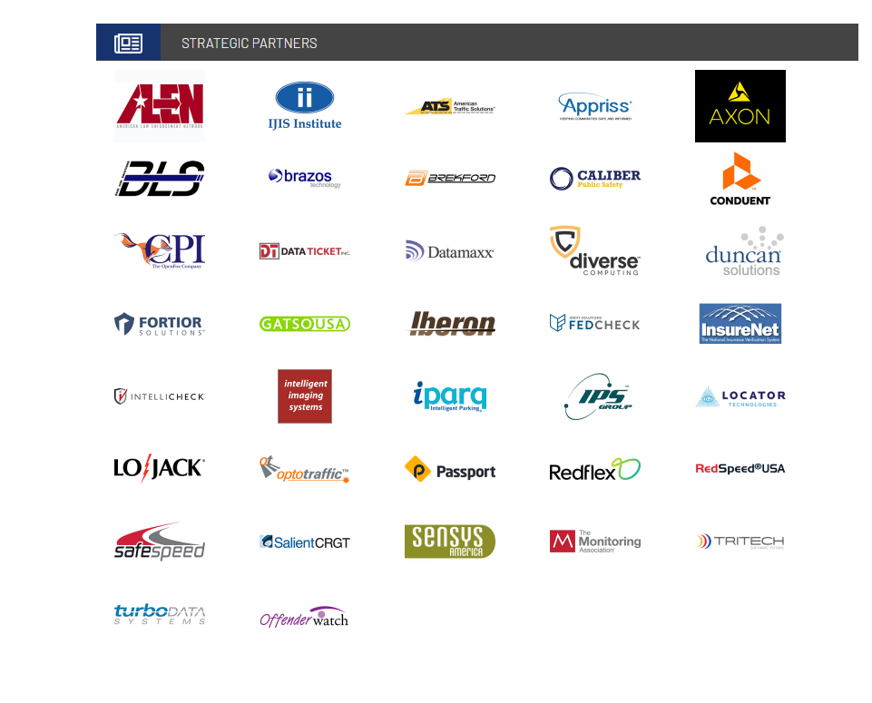
Strategic Partners
Must support public safety or other like-minded law enforcement entities (e.g., red light camera companies).

Slide 12
Our membership is represented by one individual per state. This is the Nlets Rep.
The states are divided into eight regions. Each region elects a Chairperson to represent the region on the Nlets Board of Directors.
Board consists of the President, First Vice President, Second Vice President, and Regional Chairs.

Slide 14
Technical Operations Committee (TOC) – Provides information and policy guidance to the BOD on matters of operations, maintenance, and enhancement of the Nlets system.
Finance and Management Committee (F&M) – Provides information and policy guidance to the BOD on fiscal and management matters as they pertain to the operations and administration of Nlets.

Slide 15
Training & Education Committee – Provides information and guidance to the BOD on matters related to the Nlets training program.
Brodie Assistance Fund Committee – Provides recommendations for approval of BAF applicants to the BOD.

Slide 16
Nlets is a computer-based message switching system that links together and supports every state, local, and federal law enforcement, justice, and public safety agency for the purposes of sharing and exchanging critical information.

Slide 17
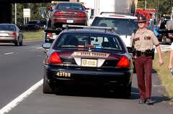
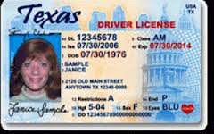
How Nlets Works
A Minnesota State Trooper pulls over a driver with a Texas driver license.
Minnesota has no internal data on Texas drivers.
A query is sent to Nlets.

Slide 18
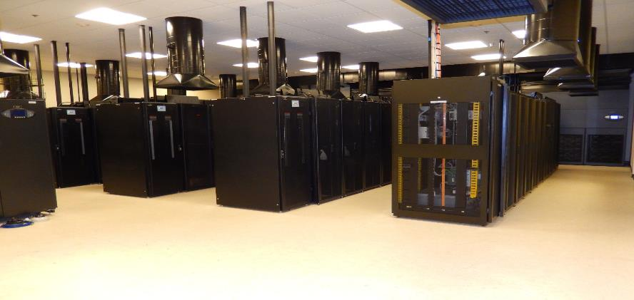
Nlets receives the query from Minnesota, checks to make sure it is a valid request, then forwards the request to Texas.

Slide 19
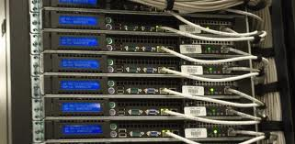
Texas receives the query, checks the info needed by the out-of-state trooper, and sends an automated response back to Nlets.

Slide 20
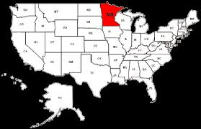
Nlets receives the response from Texas and forwards the information back to Minnesota and the requesting trooper.
All of this takes place in less than 1.5 seconds!!

Slide 21
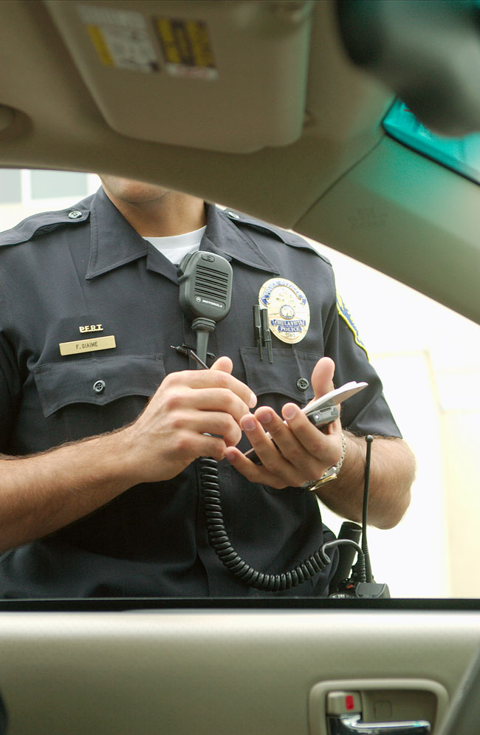
Over 2 billion transactions were processed by Nlets last year.
Notes:
2,833,032,294 transactions 11/12 – 11/13

